Slide 1
CSC 450 Final Presentation
Aengus Rafferty
Dennis Qiu
Blake McCall
Blythe Layne
Gordon Hendry

Slide 2
The Program: Music Sharing Platform
A program that acts as a platform connected to a database of music to listen to and share
Guests can browse music and playlists freely
Users can upload music and create their own playlists
Administrators can edit user and admin accounts.
Each account can do the same things as the lower-level accounts
Platform has a chat program so users can communicate with one another

Slide 3
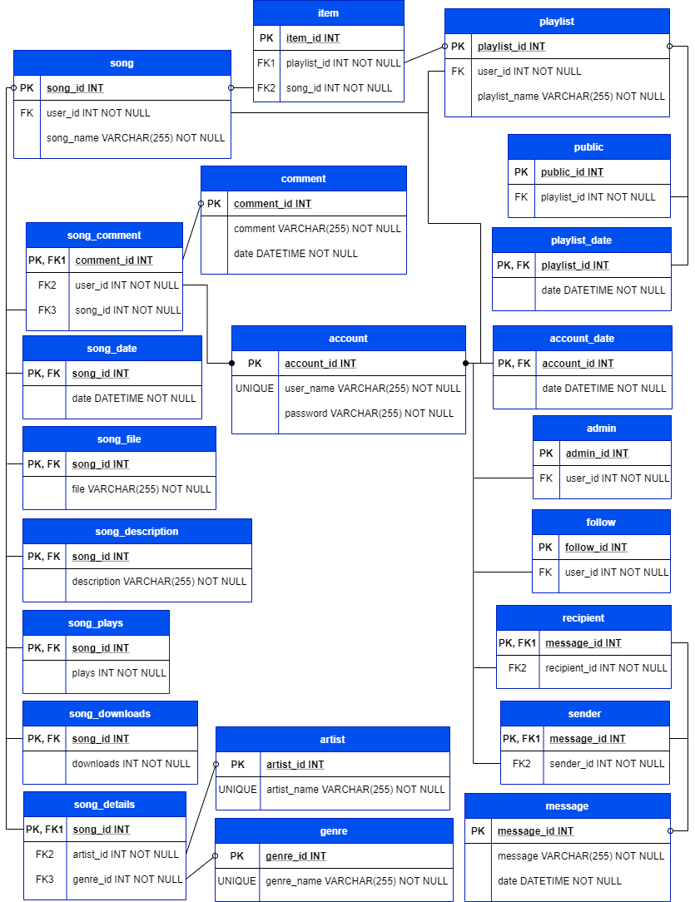
The Program: Music Sharing Platform

Slide 4
Demonstration

Slide 5
What Was The Hardest Part, Technically?
Notes:
Aengus: Figuring out what I could do to assist the team in a useful and efficient way
Dennis: Making my database, located on my computer, accessible via SSH. Apparently, the ip address I provided is a private ip address so only computers connected to my home’s network can ssh to the database.
Blythe: Working on existing code that you are not familiar with
Blake: Learning a new framework while developing software
Gordon: All working on the same code at the same time, setting up a database

Slide 6
How Close Did We Come to Our Goal?
Missing some key functionality
User authority level
Chat function
Playlists
Implemented Core Functionality
Music player
Update the song database

Slide 7
What Did We Learn?
Notes:
Aengus: I learned that coordinating even a simple sounding project with even a team this small is a major undertaking and everyone needs to pull their weight otherwise others need to pick up the slack. It’s stressful when you know you’re the one pulling the team down.
Dennis: It’s not easy for people to familiarize with unfamiliar code, even if it is designed for ease of understanding and use in mind. A big project with a big database needs more time and effort put into teamwork. It is certainly not easy when you’re limited to ONLY online meetings and NOT in-person meetings.
Blythe: Communication, make sure there is a clear understanding of responsibilities and requirements from the start
Blake: Developing a project in this amount of time is a huge task
Gordon:

